Slide 1

Storm Casualties: Predicting Dangerous Weather
Data 670 Data Analytics
Presentation 3
Daanish Ahmed
Professor: Dr. Steve Knode

Slide 2
Project Scope
U.S. storm data from NOAA and the NWS during 2017 (“Storm Events Database,” n.d.)
Problem: high frequency of storm casualties
Difficult to issue timely (and accurate) storm warnings
Predict whether a storm results in deaths
5 predictive models
Identify 5 variables that are most strongly linked to deadly storms
Text mining on storm event descriptions
Find words frequently used to describe deadly storms

Slide 3
Project Importance
High frequency of storm casualties in the U.S.
103 killed by Hurricane Harvey and Irma in 2017 (Johnson, 2017)
35 deaths from tornadoes in 2017 (“Annual U.S. Killer Tornado,” 2018)
Storm casualties are difficult to predict
45 tornado-related deaths in 2010, 553 deaths in 2011 (Brooks, 2009)
Often difficult to issue timely storm warnings
Average tornado warning time is 13 minutes (Heberton, 2014)

Slide 4
Objectives
KPIs
Model with classification accuracy of at least 80%
Sensitivity of at least 70%
Identify 5 features that contribute the most towards storm fatalities
Business Objectives
Increase storm warning time
Reduce storm false alarms
Help reduce storm casualties

Slide 5
Dataset Description
Three datasets from NOAA and NWS storm events database, 2017
Storm details (primary dataset)
51 variables, 56,921 cases
Type of storm, state, date/time, number of deaths/injuries (direct and indirect), property damage
Target variable: casualties (binary - “yes” if at least 1 death, “no” otherwise)
Skewed target (only 387 “yes” cases)
Fatalities
11 variables, 775 cases
Day/time of death, age, gender, location of death
Locations
11 variables, 43,579 cases
Storm range, direction, the town/location it occurred

Slide 6
Data Techniques/Models
2 visualizations using Tableau
Geospatial map – states with highest risk of having dangerous storms
Time series – time(s) of the year with highest number of storm casualties
1 text mining visualization using R
Word cloud of frequent terms used in “event narrative” variable
Only includes storms that had casualties
5 predictive models using SAS Enterprise Miner
Logistic regression
Neural network
Support vector machine (SVM)
Random forest
Heterogeneous model - combines regression, NN, and SVM

Slide 7
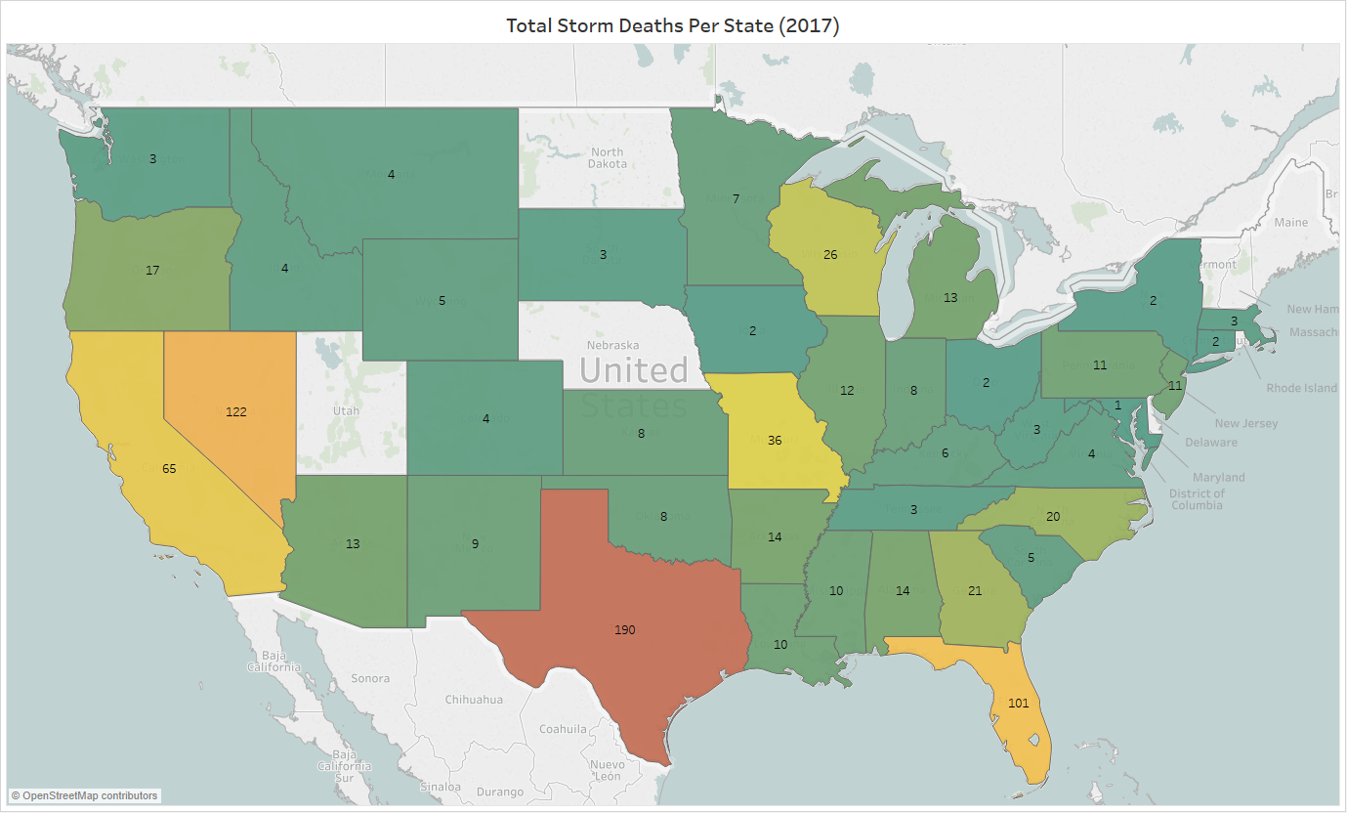
Geospatial Analysis
Texas – 190 deaths
Florida – 101 deaths
Nevada – 122 deaths
Fewer deaths in Great Plains, Midwest, South
Figure 1. Map of the Total U.S. Storm Casualties in Each State During 2017.

Slide 8
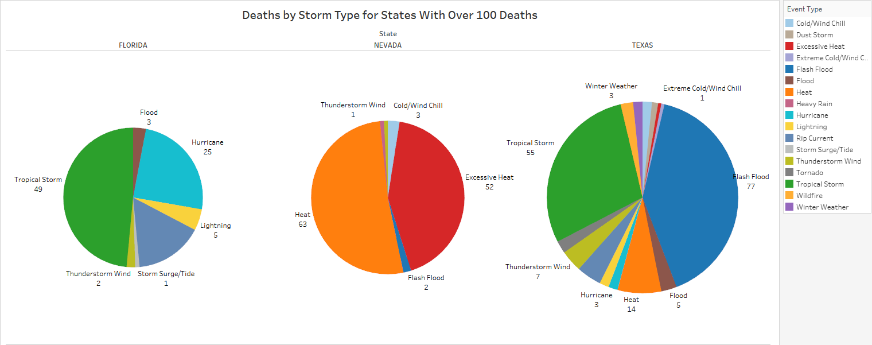
Geospatial Analysis
Figure 2. Breakdown of Deaths by Storm Type for States with Over 100 Deaths.

Slide 9
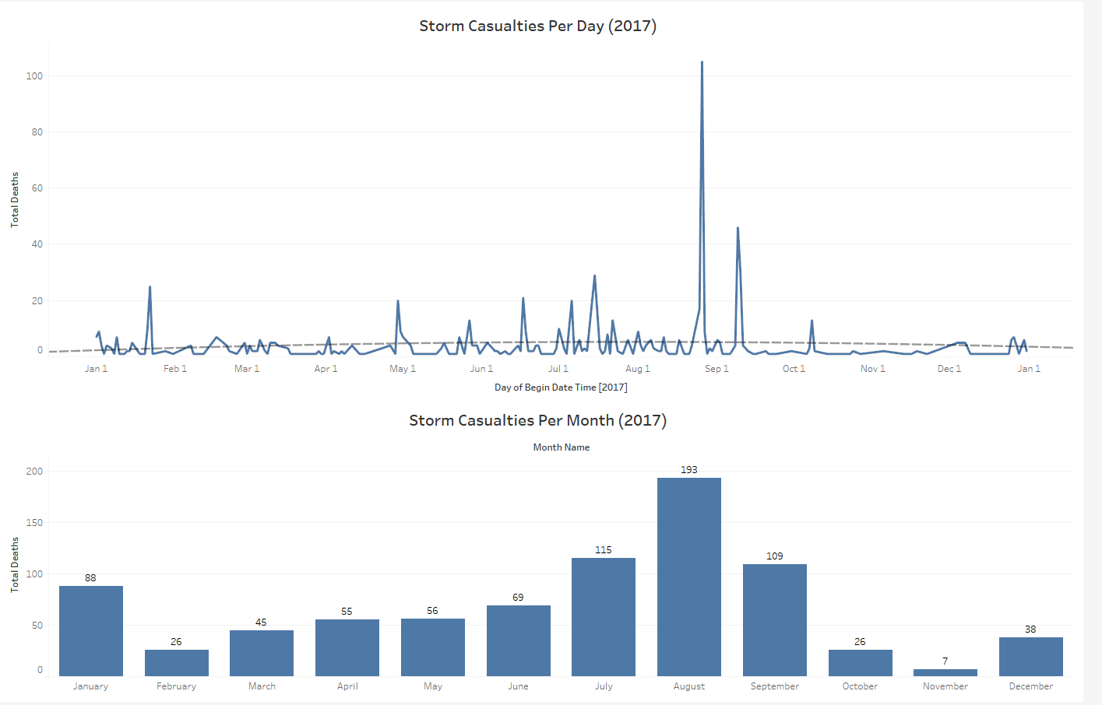
Time Series
Two graphs
Daily casualties
Monthly casualties
Deaths peak in August
Hurricane Harvey
Fewer deaths from March to June (“Tornado Season”)
88 deaths in January
Georgia tornado outbreak: over 20 lives lost (“January 21-23, 2017 Tornado Outbreak,” 2017)
Figure 3. Daily and Monthly Storm Casualties During 2017.

Slide 10
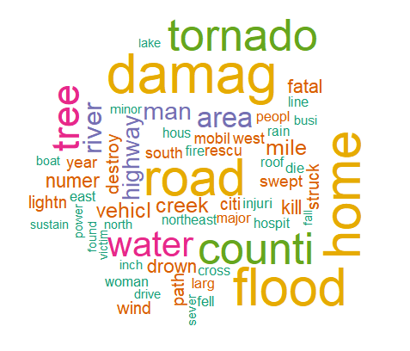
Word Cloud
60 most frequent words in storm event narratives
Only includes deadly storms
Size/color indicate frequency
Flooding deadlier than tornadoes
Location of death
Homes
Water (drowning)
Fewer deaths in vehicles or mobile homes
Issue of context
Figure 4. Word Cloud of the 60 Most Frequent Words in Storm Event Narratives.

Slide 11
Predictive Models
5 predictive models
Logistic regression – backward selection
Neural network – default
SVM – linear kernel
Random forest – default
Does not use validation/test set
Heterogeneous model – maximum method
Combines logistic regression, neural network, and SVM
Handled skewness by changing each model’s cutoff threshold
Selected cutoff value to maximize accuracy and sensitivity
Ex: logistic regression has 0.01 cutoff value, SVM has 0.41 cutoff value

Slide 12
Model Results
Model | Cutoff Threshold | Data | Accuracy (%) | Sensitivity (%)
Logistic Regression (Backward) | 0.01 | Training | 96.35 | 95.67
 |  | Validation | 95.75 | 79.71
 |  | Test | 96.05 | 77.42
Neural Network | 0.01 | Training | 96.69 | 92.61
 |  | Validation | 96.70 | 74.10
 |  | Test | 96.73 | 75.27
SVM (Linear Kernel) | 0.41 | Training | 93.90 | 93.91
 |  | Validation | 93.67 | 84.17
 |  | Test | 93.82 | 80.65
Random Forest | 0.02 | Training | 97.77 | 95.67
Ensemble (Maximum) | 0.41 | Training | 93.91 | 95.24
 |  | Validation | 93.58 | 87.68
 |  | Test | 93.90 | 84.95
Figure 5. Final Model Comparison Table.

Slide 13
Model Results
Random forest
Higher training accuracy/sensitivity
Does not require building three separate models
Provides important variables
Heterogeneous model
Highest validation/test sensitivity
Important variables provided by logistic regression
Achieves initial sensitivity of 70.3%, the highest of any model
Fulfills accuracy and sensitivity KPIs without changing cutoff threshold
Champion model: heterogeneous model

Slide 14
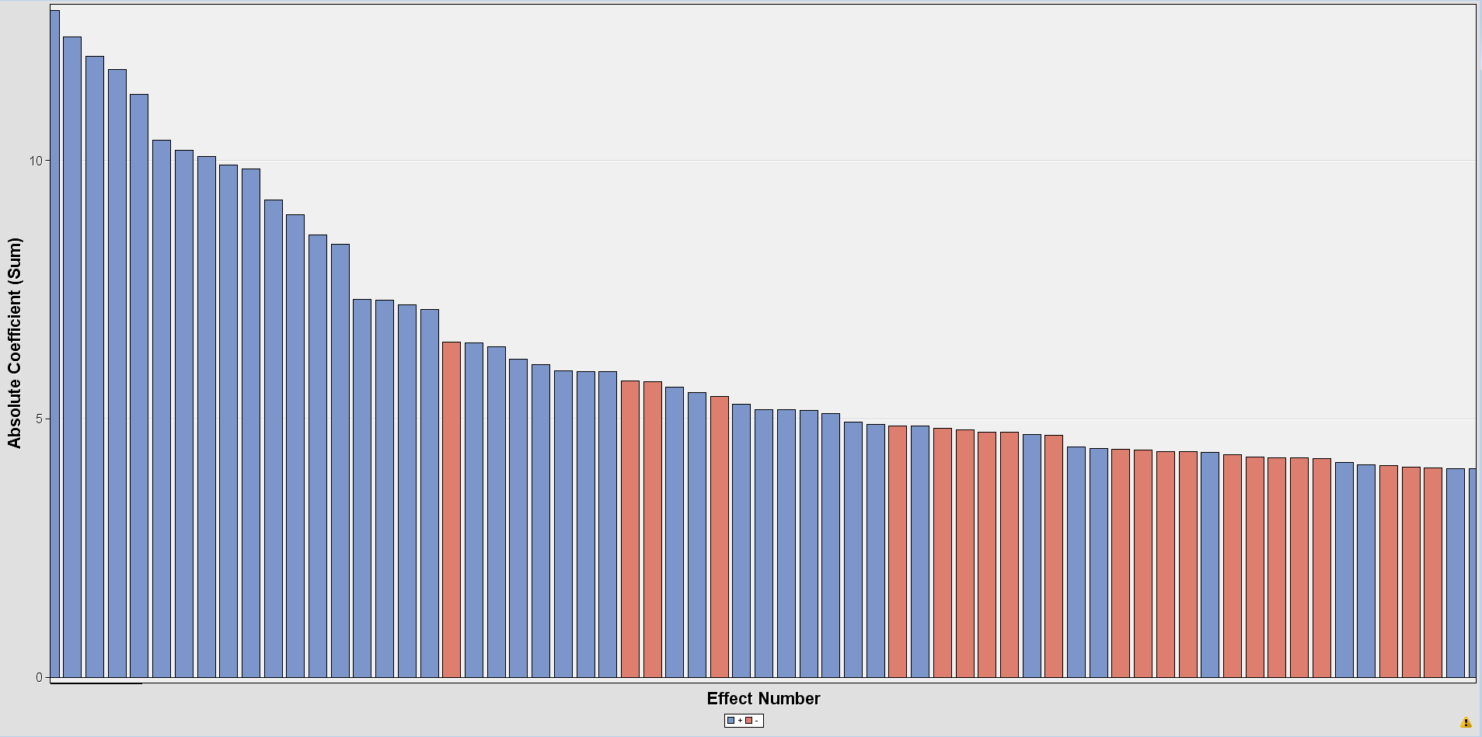
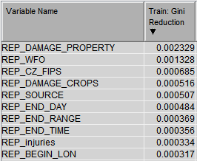
Important Variables
Figure 7. Top 10 Input Variables in Random Forest Based on Gini Reduction.
Figure 6. Graph of Regression Coefficients for Backward Logistic Regression Model.
A higher Gini reduction score corresponds with a more important input variable (Thoplan, 2014).
Property damage
Location (WFO, CZ FIPS)
Crop damage
Storm range
Injuries

Slide 15
Conclusion
All models fulfill two of my KPIs
Accuracy of at least 80%
Sensitivity of at least 70%
Recommended model: heterogeneous model
Most important inputs: property damage, location (county/region), crop damage, storm range, injuries
Location - casualties vary depending on where major storms occur each year
Time of year – deaths don’t always occur during the expected months

Slide 16
Conclusion
Lessons learned:
Correlated variables from fatalities dataset
Insights from the data
Massive death toll in Nevada caused by heat
Possibility of tornado outbreak in January
Recommendations:
Expand analysis to cover multiple years
Additional text mining components
Word associations
Correlation plots

Slide 17
References
Annual U.S. Killer Tornado Statistics. (2018, January 16). Retrieved June 12, 2018, from http://www.spc.noaa.gov/climo/torn/fatalmap.php
Brooks, H. (2009, March 1). US Annual Tornado Death Tolls, 1875-Present. Retrieved June 12, 2018, from https://blog.nssl.noaa.gov/nsslnews/2009/03/us-annual-tornado-death-tolls-1875-present/
Heberton, B. (2014, April 24). 13 Minutes: The Average Warning-Time Before a Tornado Hits. Retrieved June 1, 2018, from https://www.theatlantic.com/technology/archive/2014/04/13-minutes-thats-the-average-warning-time-before-a-tornado-strikes/361195/
January 21-23, 2017 Tornado Outbreak One of Largest Winter Outbreaks on Record in U.S. (2017, January 26). Retrieved July 14, 2018, from https://www.wunderground.com/news/severe-weather-forecast-south-high-risk-tornadoes-january-2017
Johnson, D. (2017, September 24). Is 2017 the Worst Hurricane Season Ever? Retrieved June 12, 2018, from http://time.com/4952628/hurricane-season-harvey-irma-jose-maria/
Storm Data Export Format, Field names. (n.d.). Retrieved May 31, 2018, from https://www1.ncdc.noaa.gov/pub/data/swdi/stormevents/csvfiles/Storm-Data-Export-Format.docx
Storm Events Database. (n.d.). Retrieved May 31, 2018, from https://www.ncdc.noaa.gov/stormevents/details.jsp
Texas Tornado Facts. (n.d.). Retrieved July 13, 2018, from https://www.tornadoalleyarmor.com/locations/dallas/texas-tornado-facts
Thoplan, R. (2014). Random Forests for Poverty Classification. International Journal of Sciences: Basic and Applied Research. Retrieved July 24, 2018, from https://www.researchgate.net/publication/264785074_Random_Forests_for_Poverty_Classification.

